Slide 1
Webscraping
with Perl

Slide 2
Why use Perl for Webscraping?
Perl is often a reviled language:
It has the processing disadvantages of being high level…
...but without the easy to read code you would expect of a high level language like Python or Ruby.

Slide 3
So why keep Perl around?
Perl is kept around for two reasons:
Legacy purposes: there’s a lot of historical inertia behind the language
Its ability to parse text efficiently, (e.g. regex)
Perl’s regex abilities can potentially make it a useful webscraper

Slide 4
What is webscraping?
Webscraping is the practice of drawing content from the web and parsing it for useful data to be used in third party applications.
Normally a site will serve content to end users using a browser, but it’s also possible for scripts to grab copies of the data as well.
This has commonly been used in bots used by search engines, for example, attempting to apply algorithms to the site’s content and rank it in response to various searches.

Slide 5
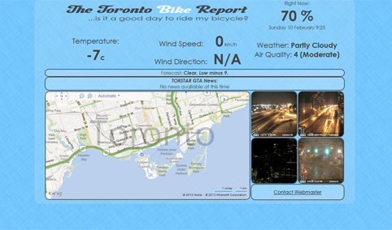
Example - Toronto Bike Report
Other applications (such as those we’re looking at today) use these data for aggregation purposes.
TBR is written in python as a
CGI script, so it’s not a
suitable example of Perl
scraping, but it gives an idea
of what simple web scraping
applications can do.

Slide 6
Example - Toronto Bike Report
TBR scrapes data from Environment Canada, Bing traffic maps of the city, the Toronto Star’s RSS feeds, and the City of Toronto’s webcam network.
It not only reports these data,
but produces an aggregate
‘metascore’ for the present
conditions as they relate to
cycling.

Slide 7
Example - findTitleOfURL.pl
Let’s look at a simple Perl web scraping script: findTitleOfURL.pl
I’ve somewhat arbitrarily identified 3 phases to this script.
0: Setup - the script’s skeleton
e.g. shebang line, import of modules, etc.
1: Acquire Data from the Web
Connect to URL and receive HTML data
2: Parse Captured Data
Either naively with regex or using a DOM module
3: Report Data
Format captured data and do with it as you please

Slide 8
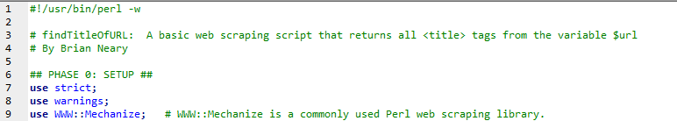
Phase 0: Setup
Other than typical boilerplate code, the most important item to note in this example is the use of WWW:Mechanize, a library designed to facilitate web scraping.
Whatever language you’re using, there are likely at least several libraries designed to help with you a task like this, (e.g. BeautifulSoup in Python).

Slide 9
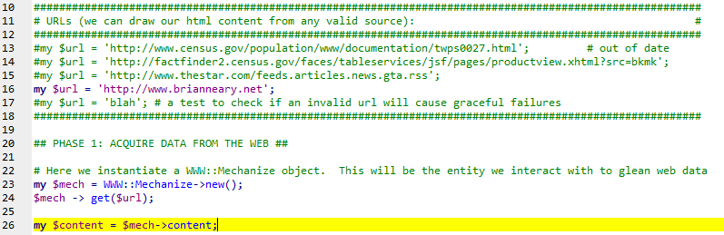
Phase 1: Acquire Raw Web Data
This is where we use the library (or baked in technology) of our choice to establish a connection to the web and pull data from a URL. Here we create a $mech object to glean its $content

Slide 10
Phase 1: Acquire Raw Web Data
It’s generally a best practice to save your URL as a separate variable rather than passing a string directly into the argument. Some developers even break up the URL into multiple variables (e.g. the top domain in one variable and the rest of the URL in another).

Slide 11
Phase 1: Acquire Raw Web Data
The result of Phase 1 is typically either a DOM object that you can parse using an appropriate HTML/XML parsing tool, or a string that you can pattern match against. In this case I’ve captured the page’s contents into a string in the scalar variable $content.

Slide 12
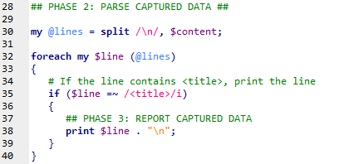
Phase 2: Parse Captured Data
In many languages, this is where you’d be forced for the sake of efficiency to draw upon the parsing power of a purpose built DOM library, which is useful. Perl’s strength, however, is pattern matching and regex, and we can use that here.
I simply split the string on newlines, iterate, and return the first line with ‘<title>’ in it. Easy. When you have more complex requirements--or want to write production code--use a parser module.
If you write ‘naive code’ to do scraping like
this rather than a proper library, be advised
that this can leave you open to security issues
and hacking. Try to use a library whenever
possible.

Slide 13
Phase 3: Reporting
Here I’m just using a print statement, but once you’ve captured your data, you can pretty much do whatever you please with it.

Slide 14
Resources
WWW::Mechanize:
http://search.cpan.org/~sargie/WWW-Mechanize-Boilerplate-0.03/README.pod
HTML::TreeBuilder (a perl DOM parser):
http://search.cpan.org/~cjm/HTML-Tree-5.03/lib/HTML/TreeBuilder.pm
Webscraping for Fun and Profit:
http://blog.hartleybrody.com/web-scraping/
Web Scraping modules in different languages:
http://stackoverflow.com/questions/2861/options-for-html-scraping

